Slide 1
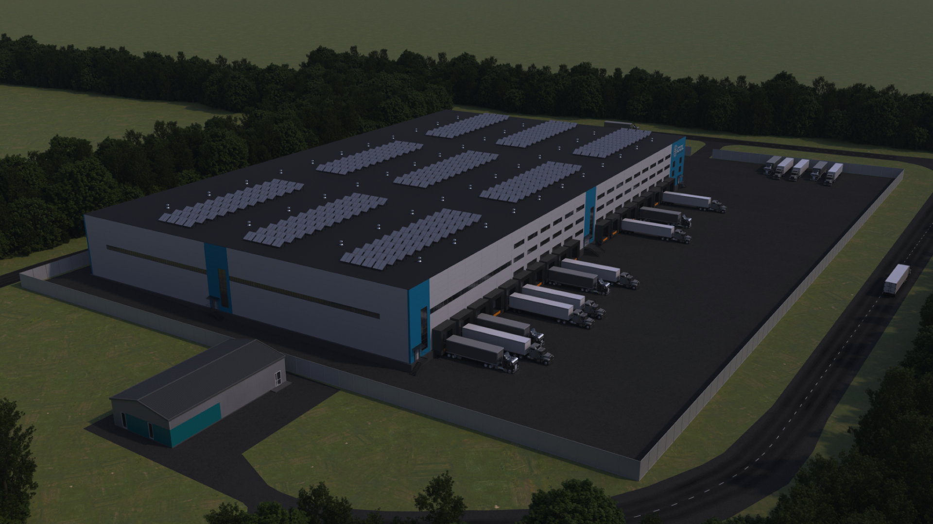
SOLOMONOVO
LOGISTICS COMPLEX
Solomonovo, Zakarpattia region, Ukraine
Commercial proposal

Slide 2

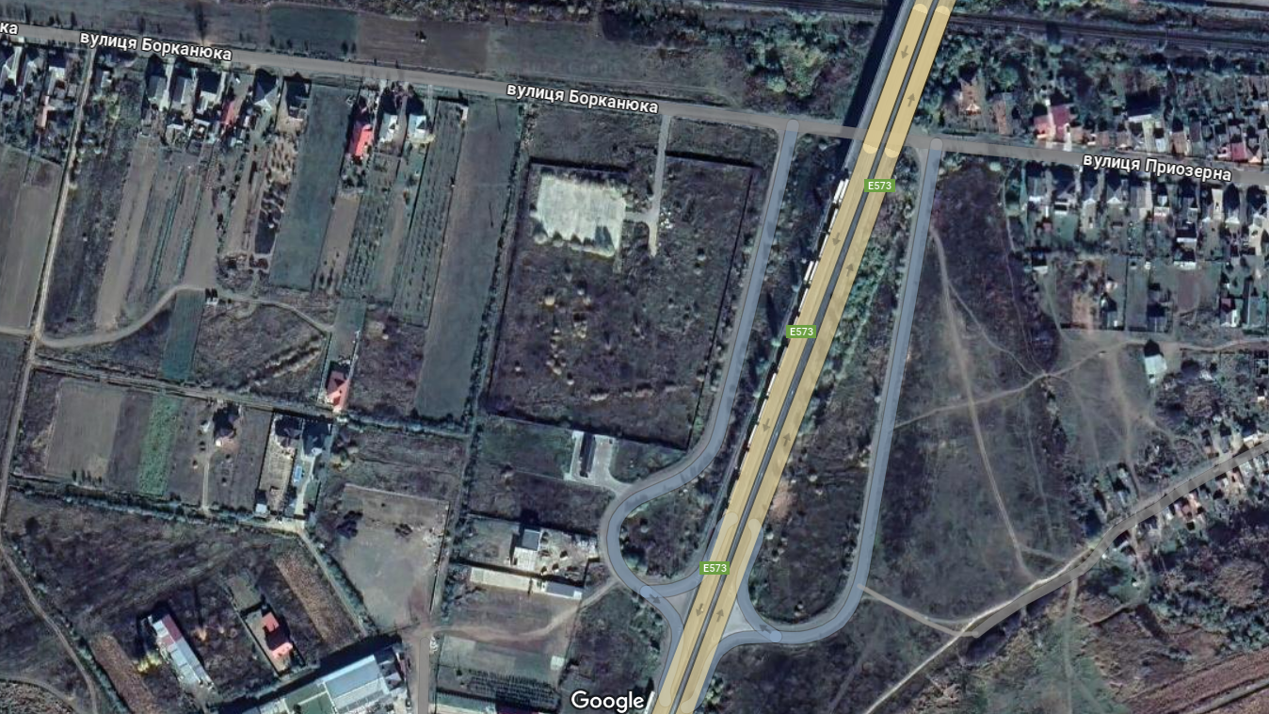

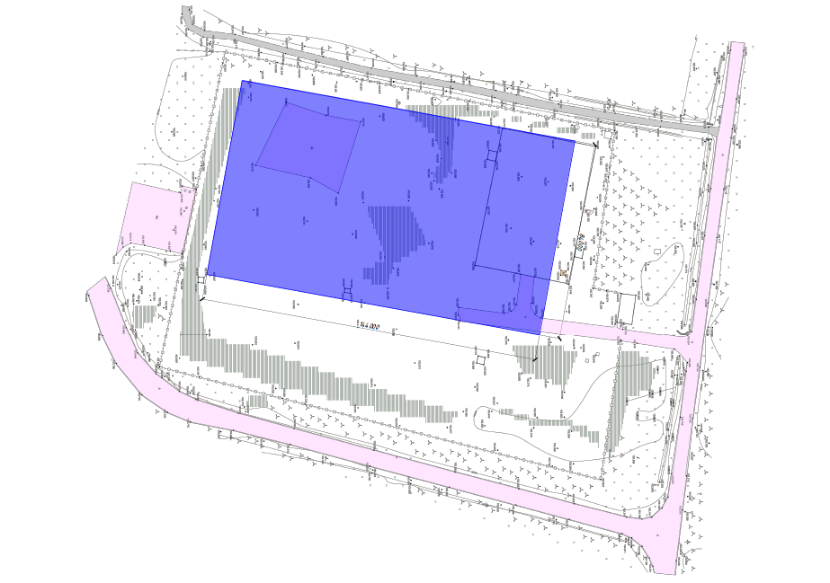
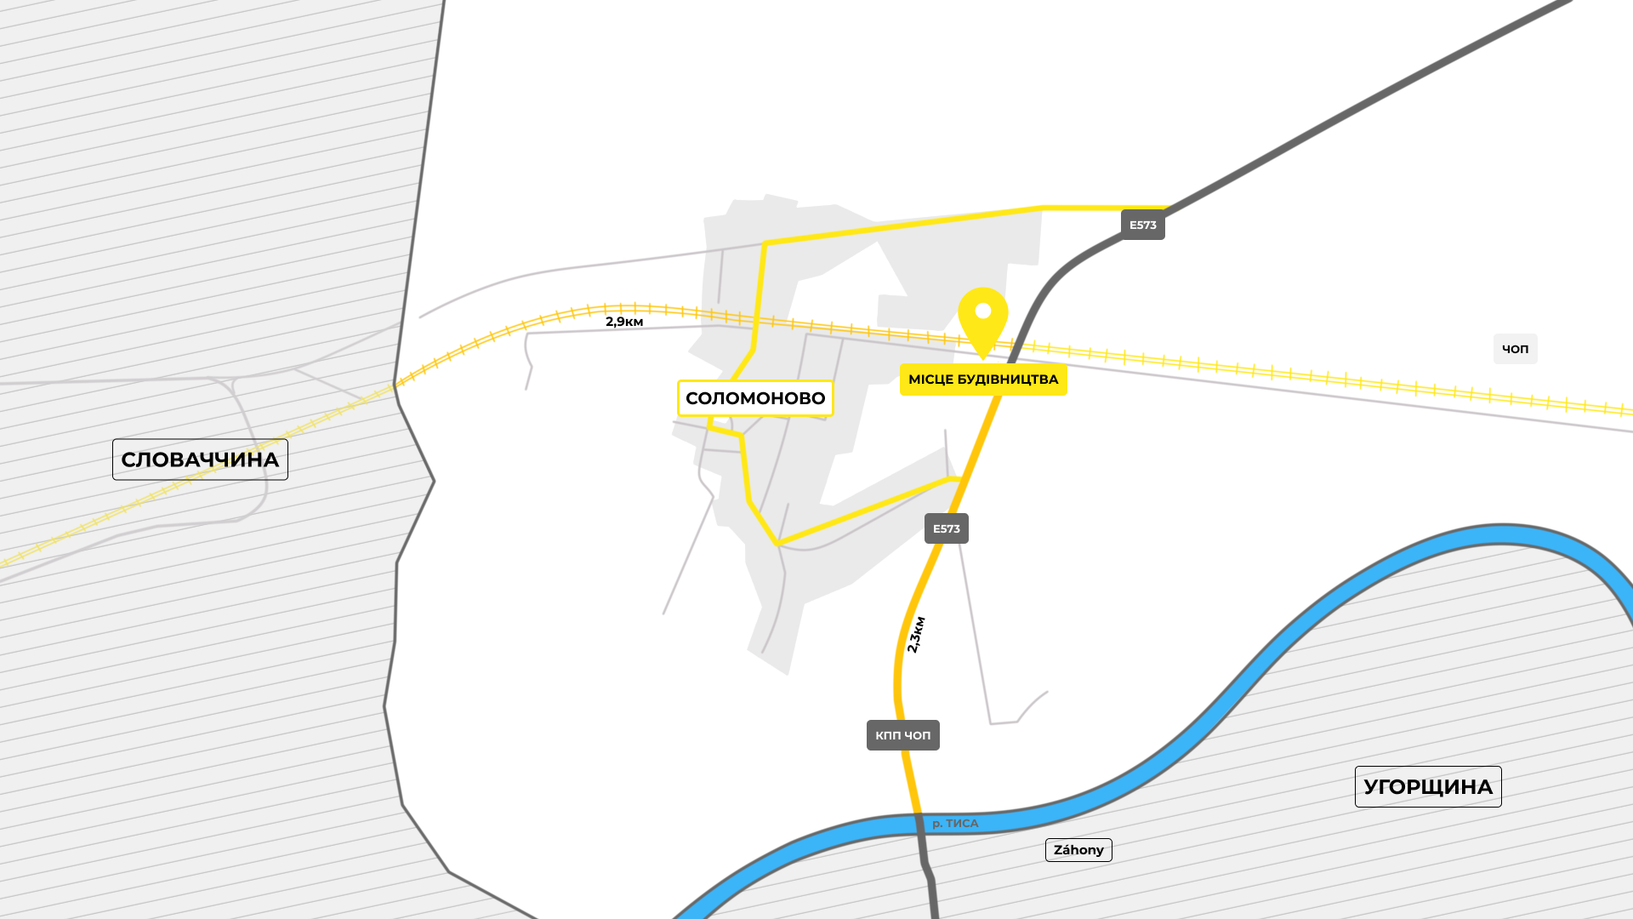
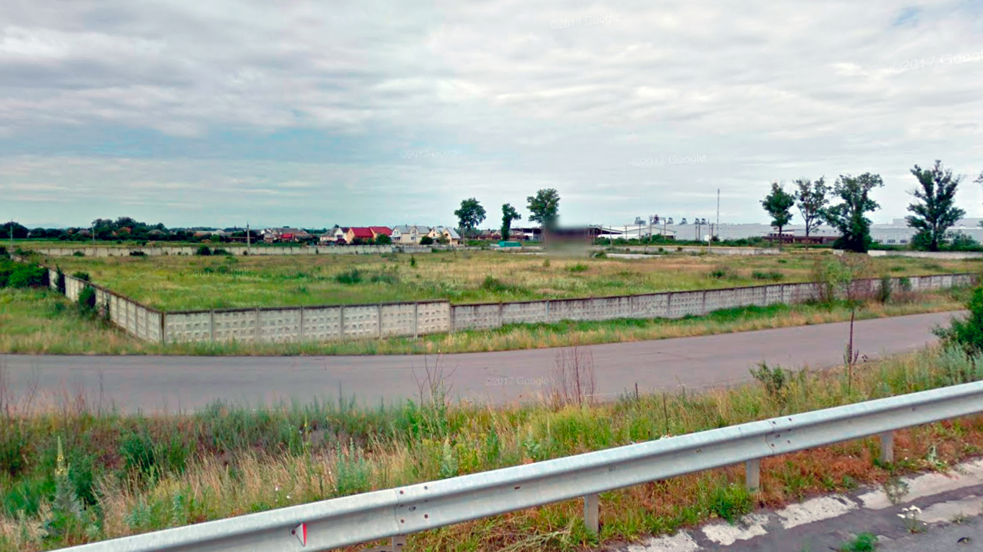
ABOUT THE PROJECT
A new logistics warehouse complex in the village of Solomonovo, Zakarpattia region with a total area of ​​3,6 ha, including 13,070 m² of warehouse space, offices and technical premises.
One of the most advanced locations:
the distance to the border with Hungary is 2.0 km
the distance to the border with Slovakia is 2.9 km
The possibility of further expansion of warehouse capacities in the next stages of construction.
ДІЛЯНКА ПІД ЗАБУДОВУ

Slide 3
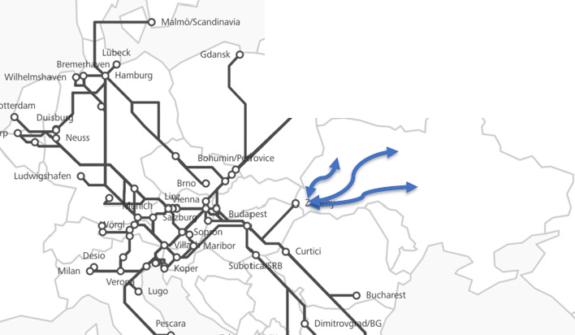
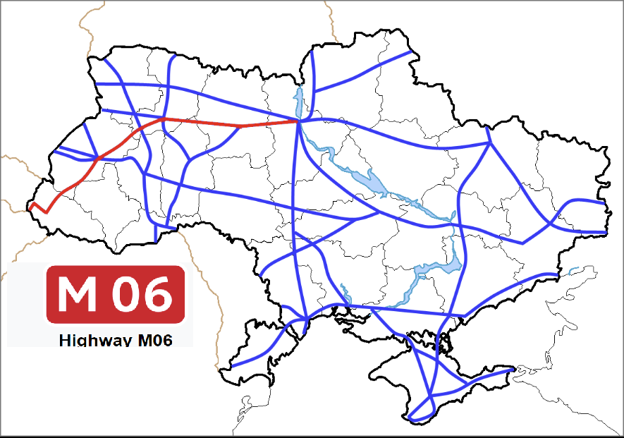
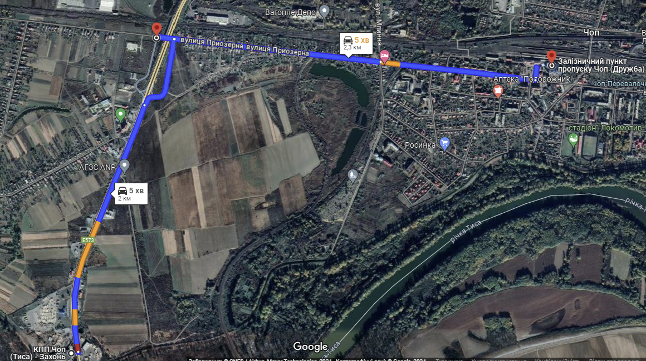
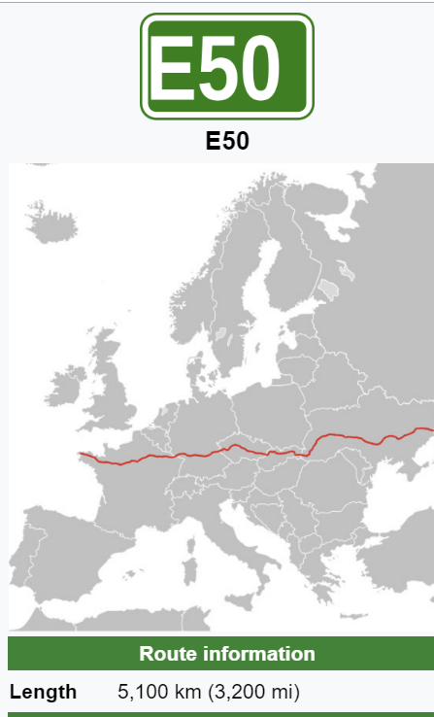
transport CONNECTIONS
RAIL CONNECTION: distance 2,3 km
Chop terminal "Lisky" - for transshipment of containers from the European railway track of 1435 mm to the railway track of 1520 mm and vice versa, occupies a favorable geographical position at the junction of the borders of three states: Slovakia, Hungary and Romania.
TRUCKING CONNECTIONS :
Highway М06 — the Ukrainian international highway connecting Kyiv with Hungary near Chop continues to Zagoni and Budapest. The highway is part of the Pan-European transport corridors III and V, as well as the Europe-Asia transport corridor.
Highway Е50 - connects the city of Uzhhorod with Slovakia, the Czech Republic, Germany, and France.

Slide 4

OPPOTUNITIES
Strategic investment partnership
Build to rent
Built to sale
LOGISTICS COMPLEX GRADE-a

Slide 5
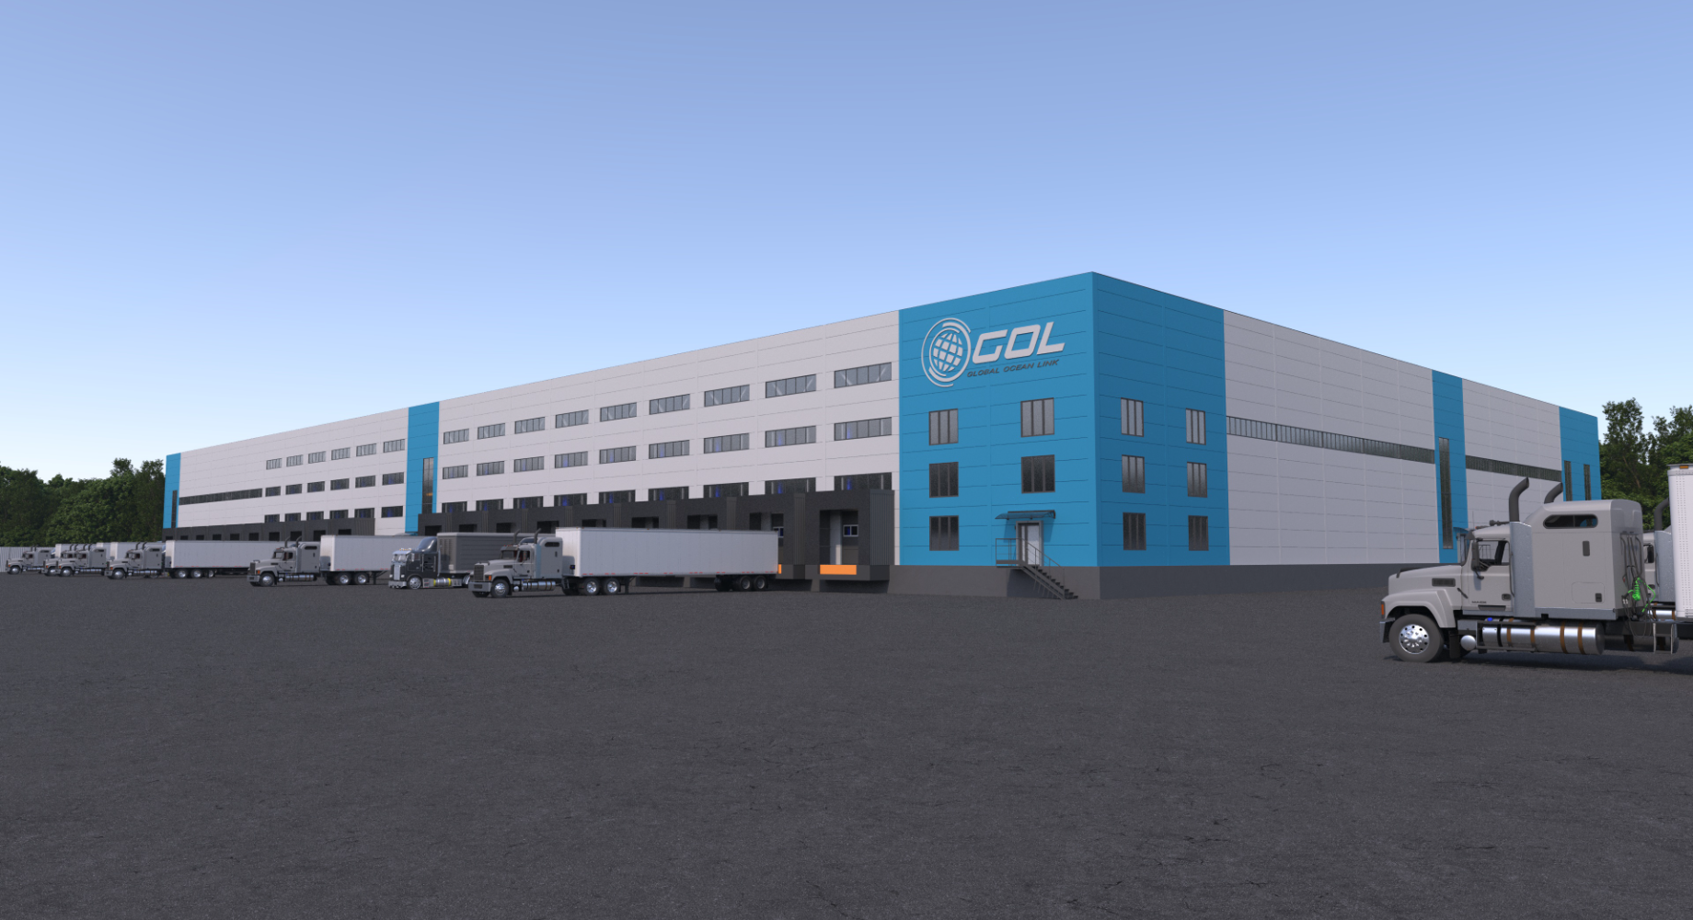
FACADE 1

Slide 6
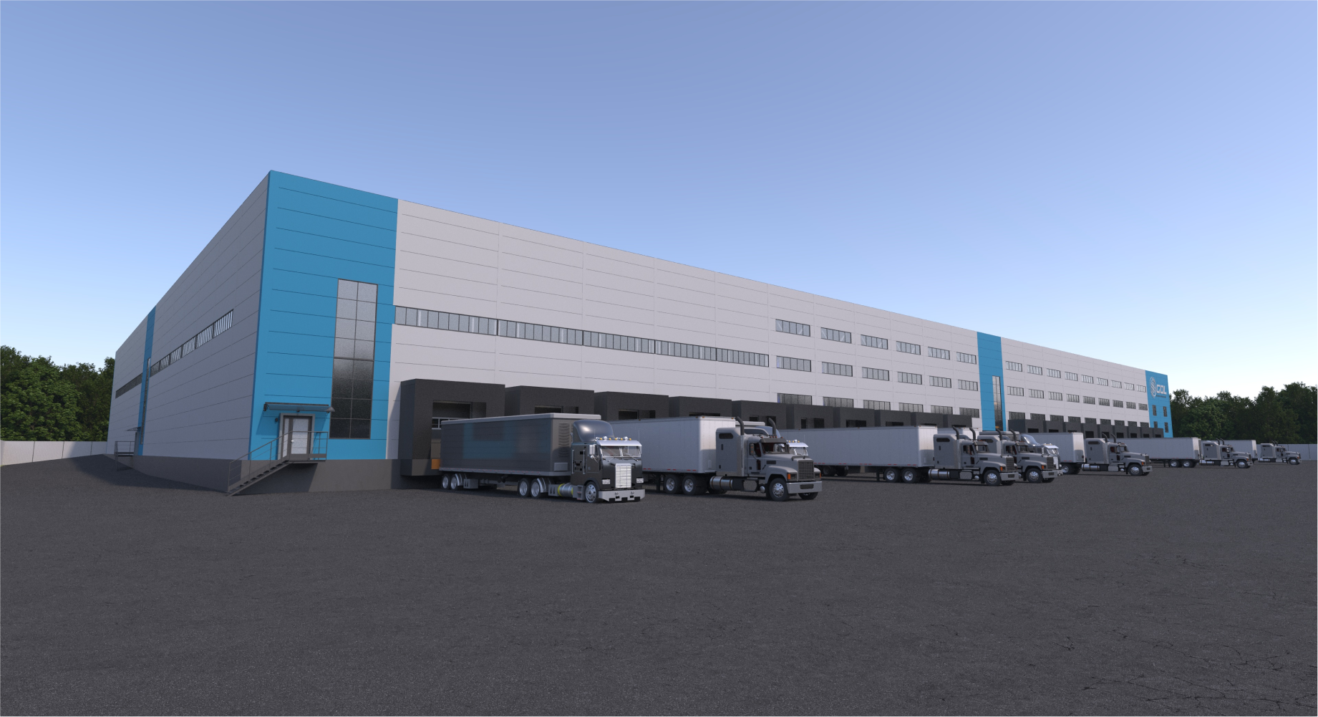
FACADE 2

Slide 7
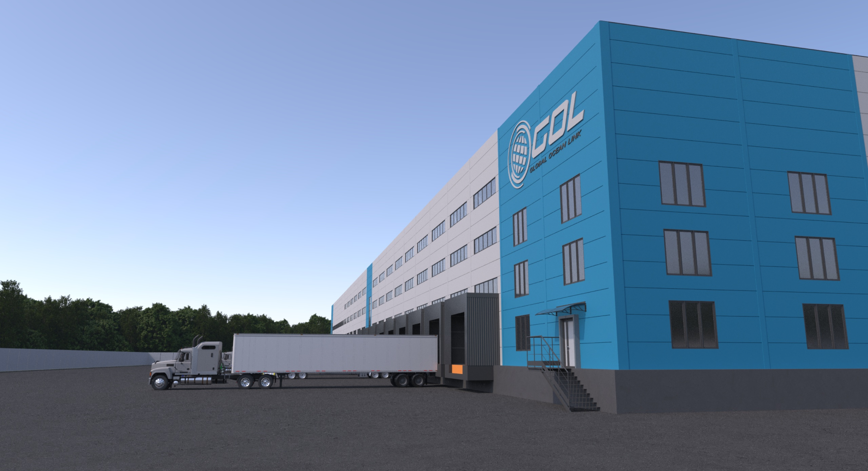
FACADE OF OFFICE PREMISES

Slide 8
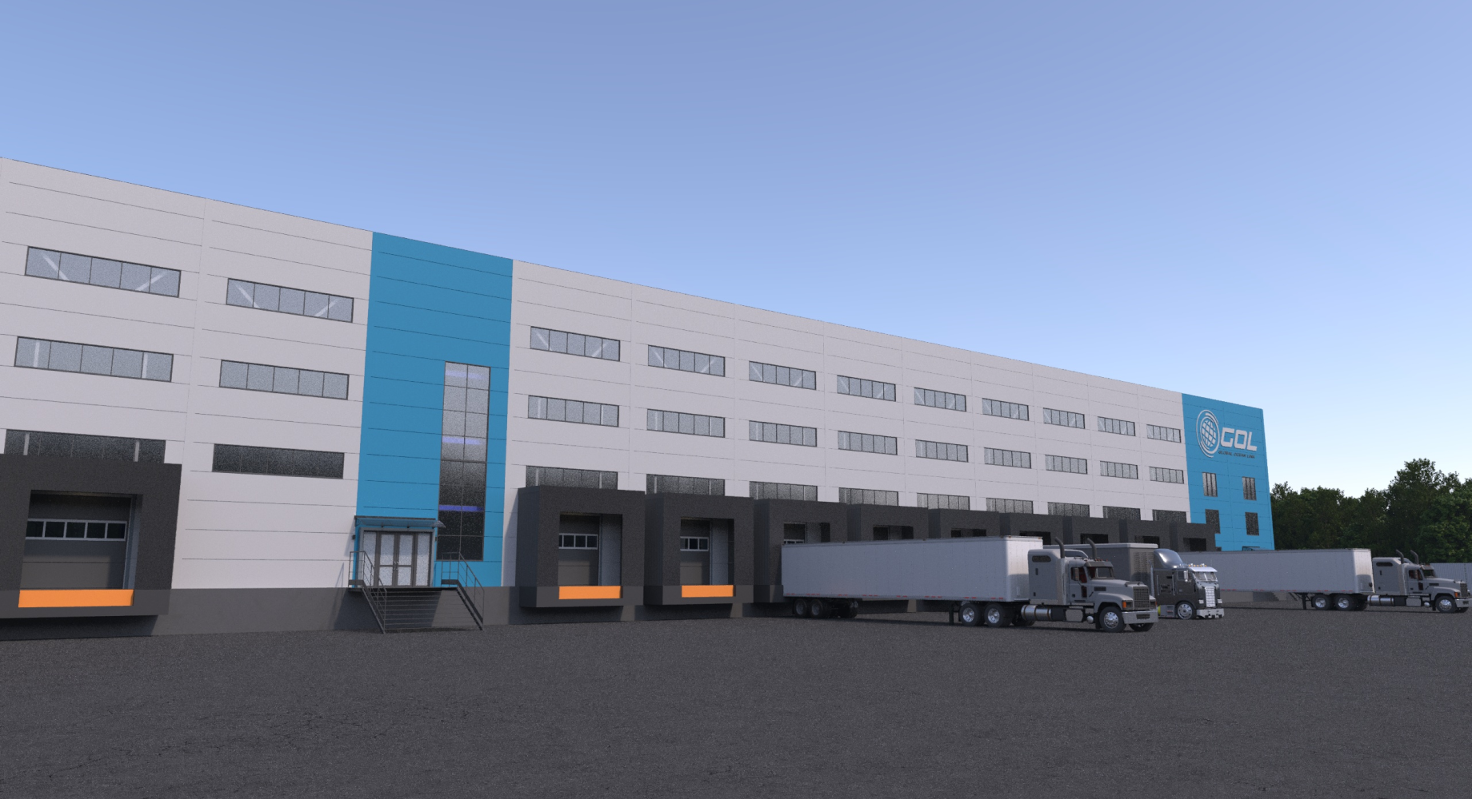
dock levelers

Slide 9
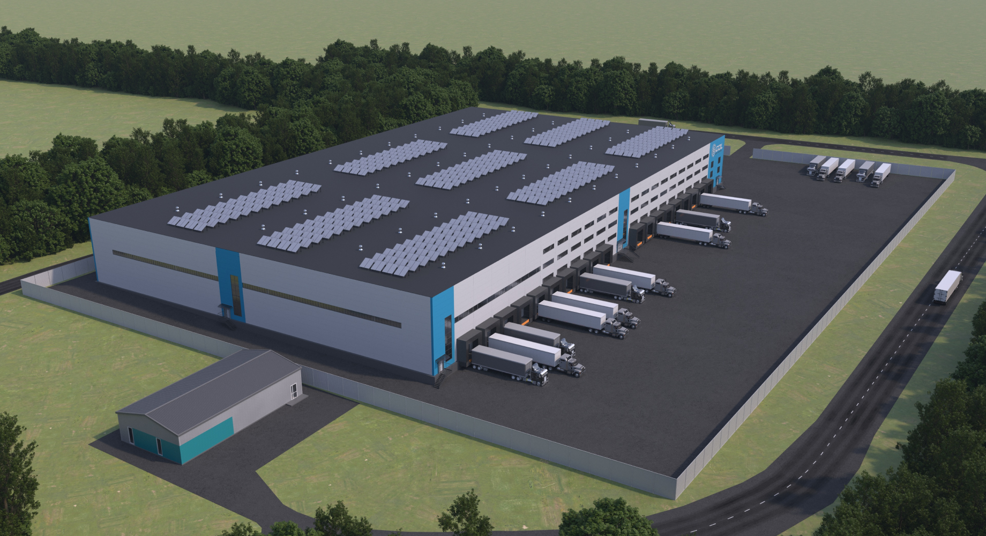
The general view of the complex - southeast

Slide 10
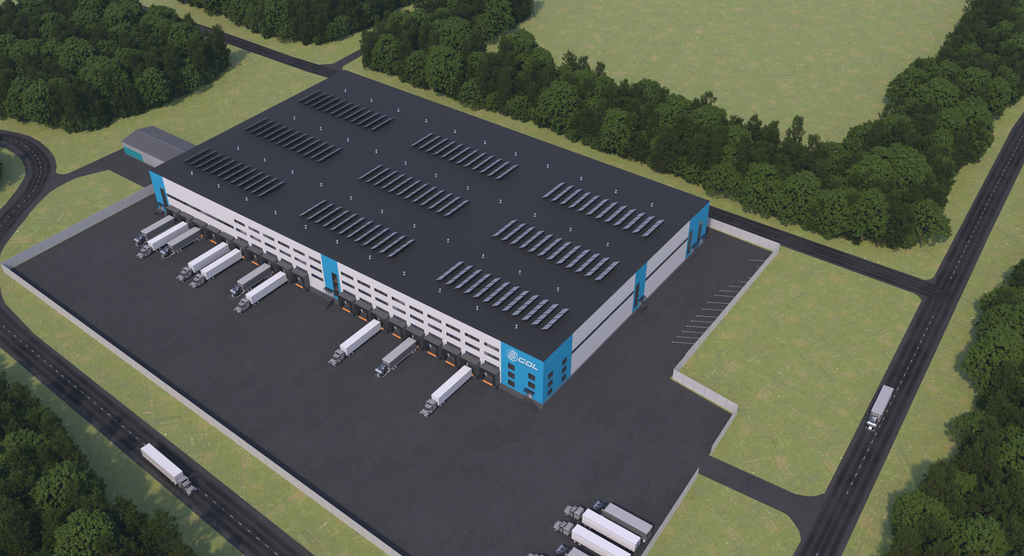
The general view of the complex - northeast

Slide 11
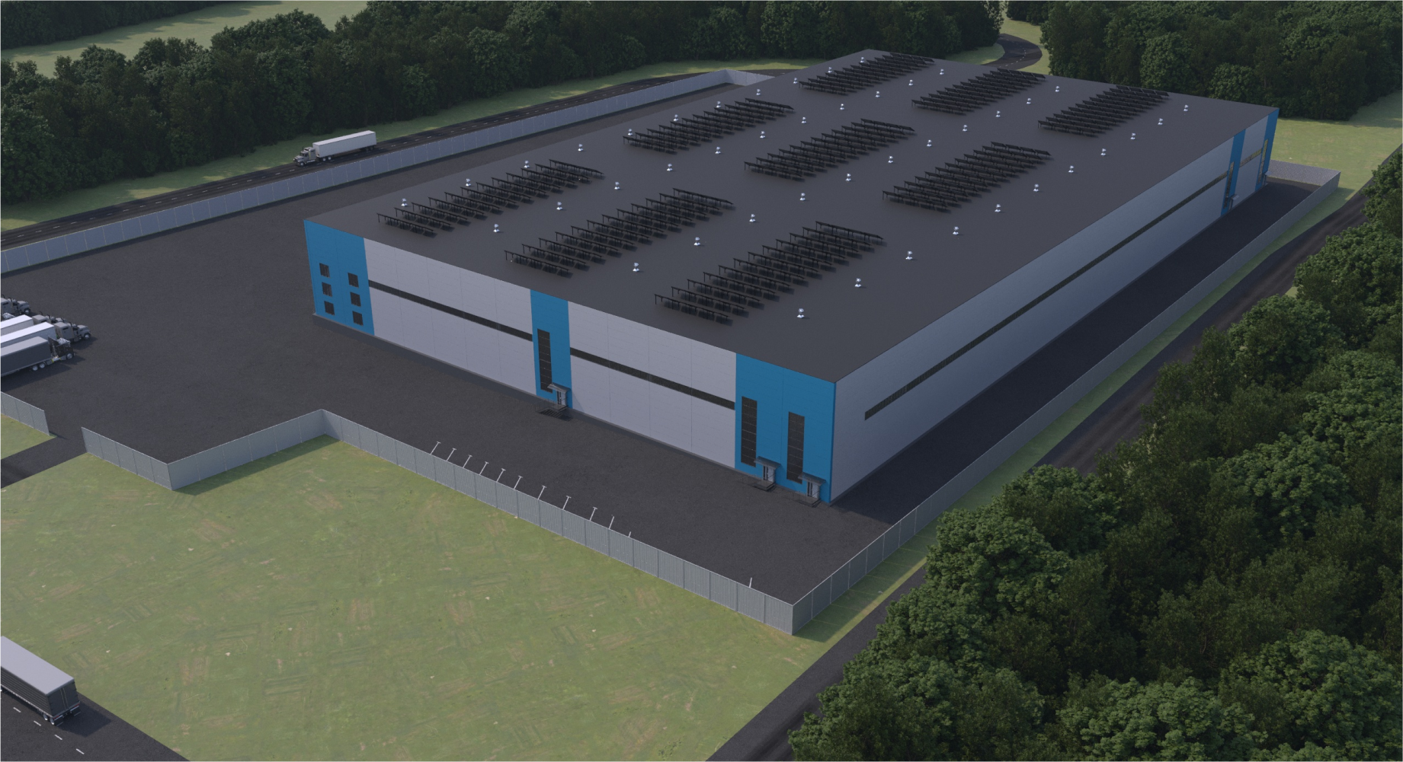
The general view of the complex - northwest

Slide 12
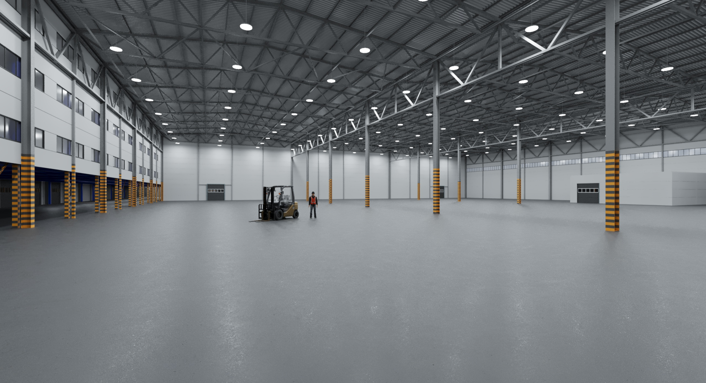
WAREHOUSE SECTION 1

Slide 13
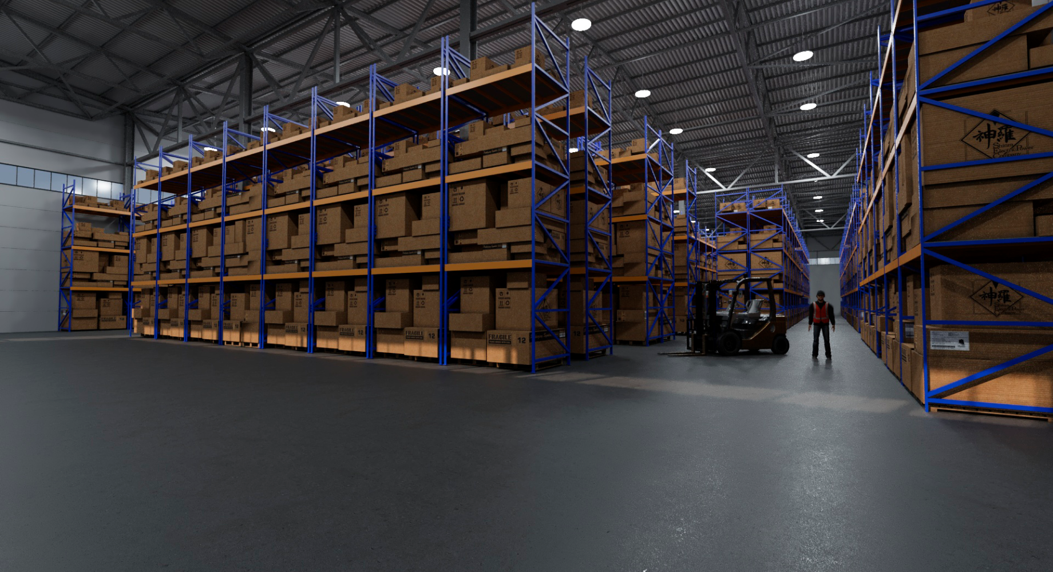
Bonded warehouse

Slide 14
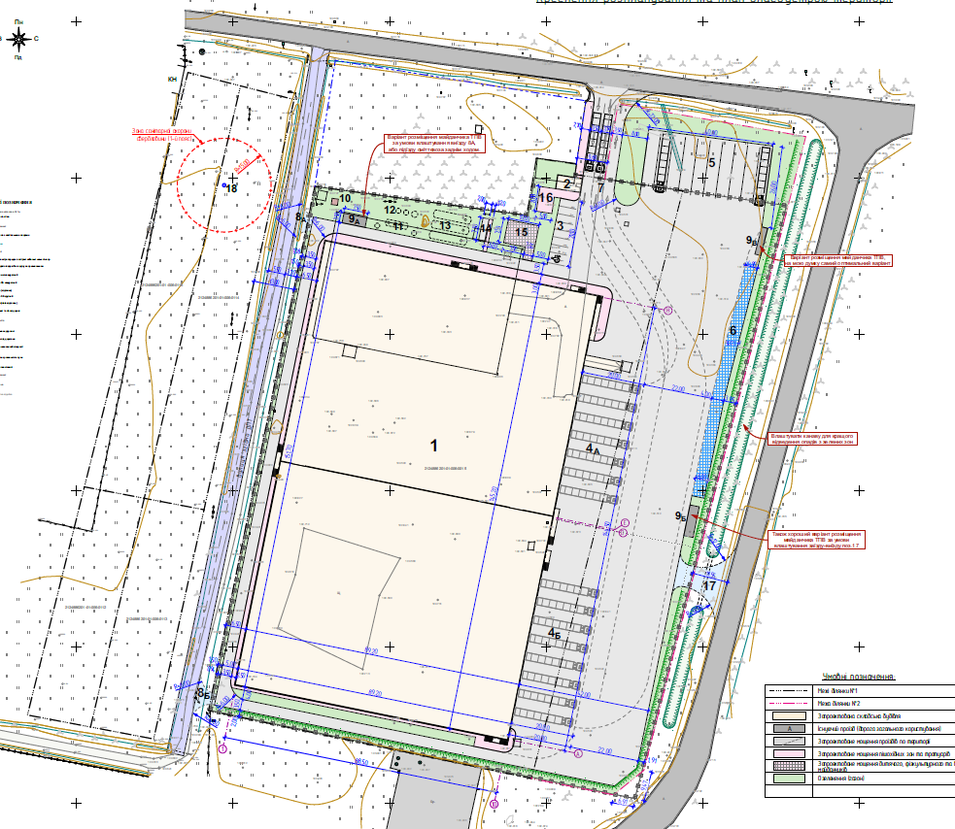
explication of the building premises
Section 1:
Warehouse space 6 387 m2
mezzanine ​​540 m2
Offices 270 m2
MHE charging room 26 m2
Shelter 117 m2
Section 2:
Warehouse space 6 479 m2
Offices 270 m2
MHE charging room 26 m2

Slide 15
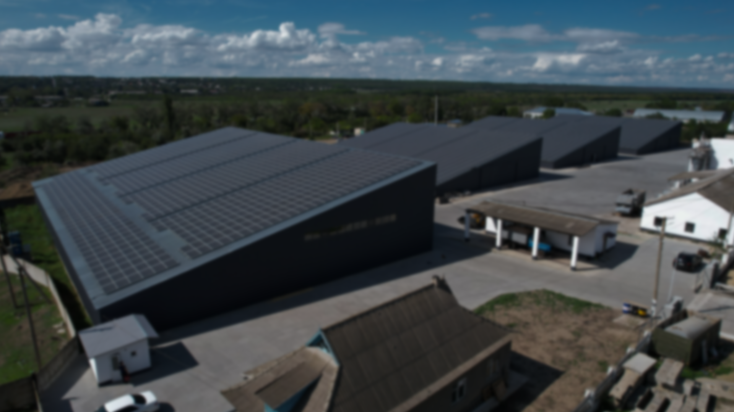
TECHNICAL SPECIFICATIONS OF THE BUILDING
LOGISTICS COMPLEX GRADE-a

Slide 16
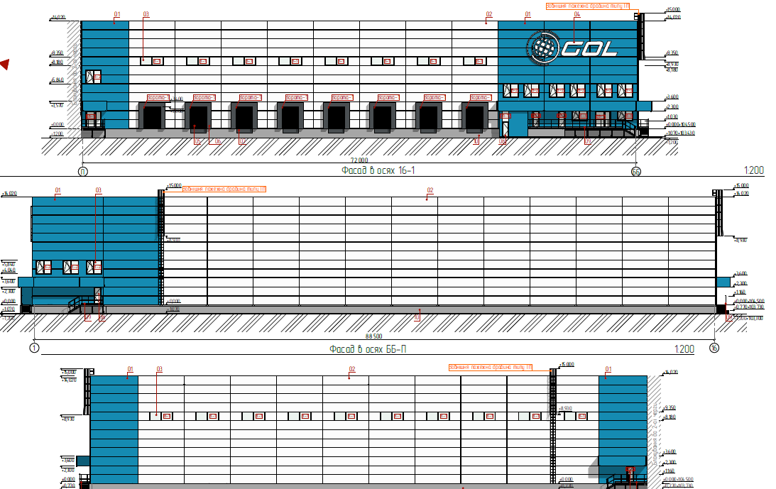
THEHNICAL SPECIFICATIONS
GENERAL SPECIFICATIONS OF THE COMPLEX
PLOT AREA
BUILDING AREA
BUILDING DIMENSIONS
USABLE AREA
GRID OF COLUMNS
CLEAR HEIGHT
DOCK LEVELERS
TRUCKS PARKING AREA
36 000 sqm
12 744 sqm
144 x 88,5 m
13 556 sqm
24х12 m
10 m
16 pc
18 trucks

Slide 17
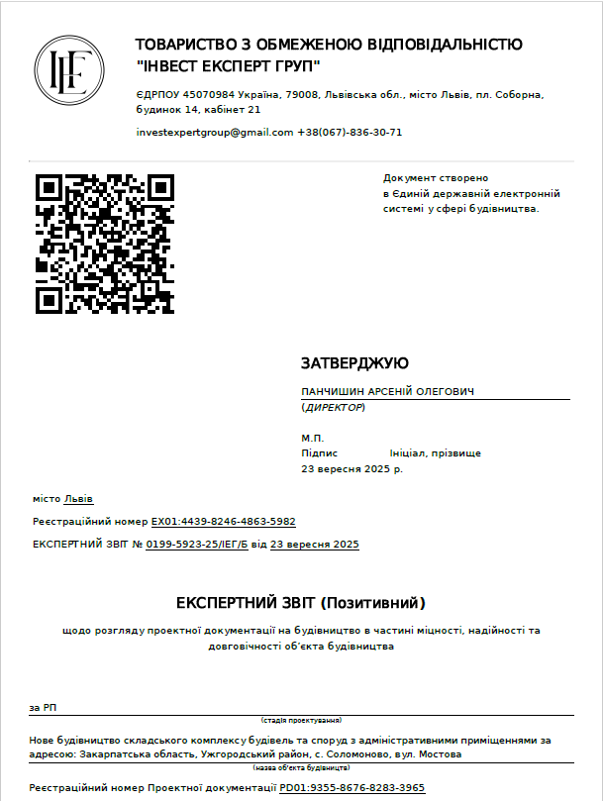
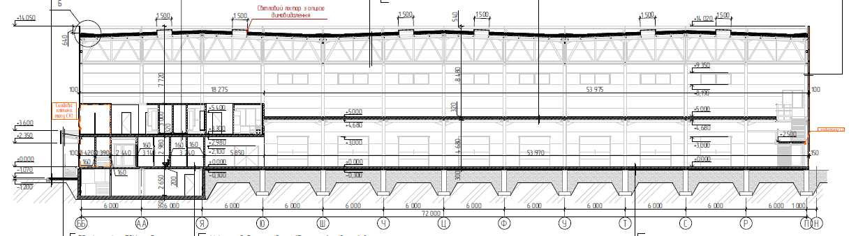
Project status
09/2025 – construction project examination passed
02/2026 - electricity supply connection
03/2026 – 10/2026 – 1st section construction and commissioning
03/2027 – 09/2027 – 2nd section construction and commissioning

Slide 18


CONTACTS
The Global Ocean Link company is the market leader of multimodal and intermodal container transportation in Ukraine. We have been working on the market of transport and logistics services since 2009. Today, the number of our team exceeds 150 specialists.
https://gol.ua
+38 (067) 555-20-00
abugay@gol-xborder.com
+38 (048) 797-20-48
sales@gol.ua

